Slide 1
Digital tillgänglighet:
EN-Standard som pekar på WCAG
johan.kling@funka.com

Slide 2

Johan Kling
COO & CQO
Webbutvecklare sidan mitten av 90- talet.
Tillgänglighetsexpert
Operativ chef & kvalitetschef för alla våra leveranser, produkter och konsulter.
Plus, jobbar aktivt med projektledning, användningstester, interaktionsdesign, systemarkitektur, utbildning och utveckling.
Certifierad via IAAP - CPWA & ADS

Slide 3

Målet för dagen
Få exempel på viktiga punkter i EN301549/WCAG relevanta för utvecklare.
Få kunskap om när WAI-ARIA är viktigt, och inte! ☺
Frågor (ca 10:45 i 15 min):

Slide 4



Under presentationen
Är det något som är otydligt eller som du inte förstår: Räck upp handen!
Om du har andra frågor:
Skriv i chatten så svarar vi under frågestunden på slutet.

Slide 5

Web Accessibility Directive (WAD)
Lagen om tillgänglighet till digital offentlig service.

Slide 6
Europeisk standard
EN 301 549 V3.2.1
som i sin tur bygger på WCAG 2.1 (Web Content Accessibility Guidelines)

Slide 7
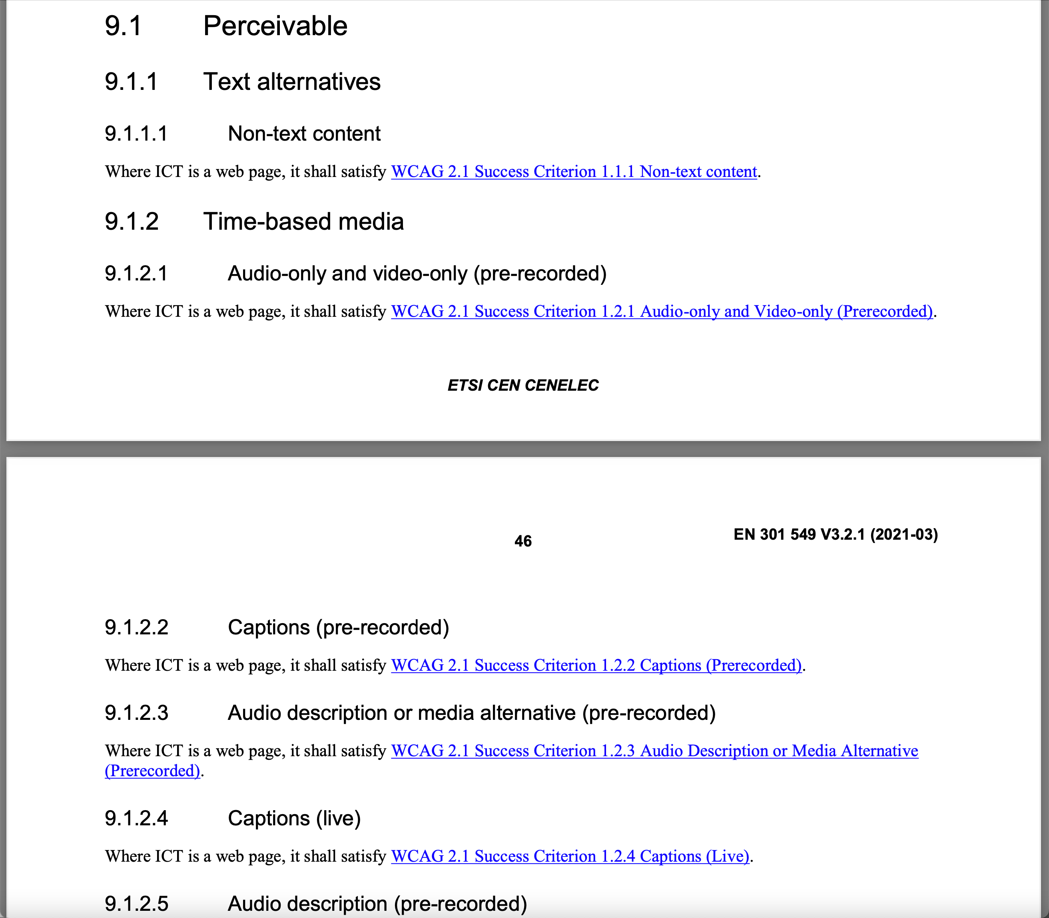


Slide 8
1: Exempel på kriterier från WCAG relevanta för utvecklare.

Slide 9
Reflow

Slide 10

All information can be accessed and used regardless of screen size
You should never limit access to information and functionality in the interface, even if it is being presented on a smaller screen.
You should also have a well-thought-out strategy for how the interface handles screen size, regarding things like line length, menus, etc.
WCAG 2.1 1.4.10 Reflow (AA)

Slide 11
The interface is viewable and usable without forcing the user to scroll in more than one direction
In vertical scrolling, the interface should only need to be scrolled in one direction down to a page width of 320 CSS pixels.
In horizontal scrolling, the requirement is down to a page height of 256 CSS pixels.
Some exceptions are allowed, for example when using data tables, diagrams or illustrations.
WCAG 2.1 1.4.10 Reflow (AA)

Slide 12
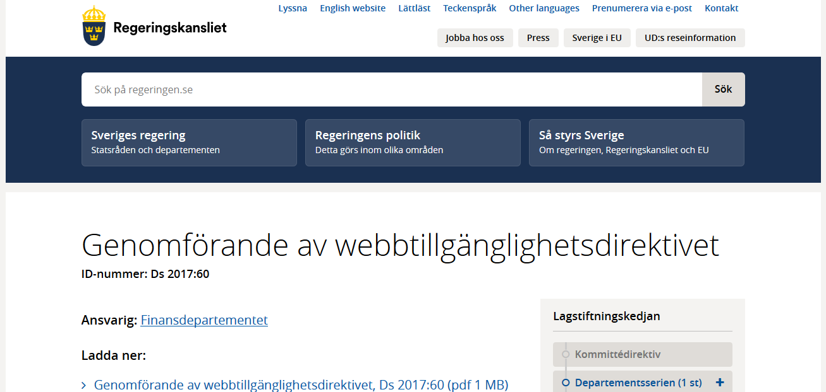
WCAG 2.1 1.4.10 Reflow (AA)

Slide 13
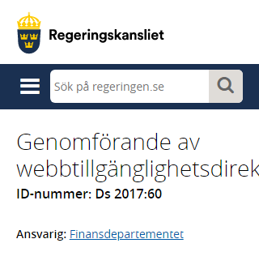
WCAG 2.1 1.4.10 Reflow (AA)

Slide 14
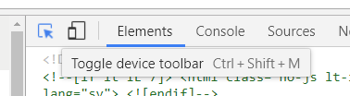
F12 in web browsers
WCAG 2.1 1.4.10 Reflow (AA)

Slide 15
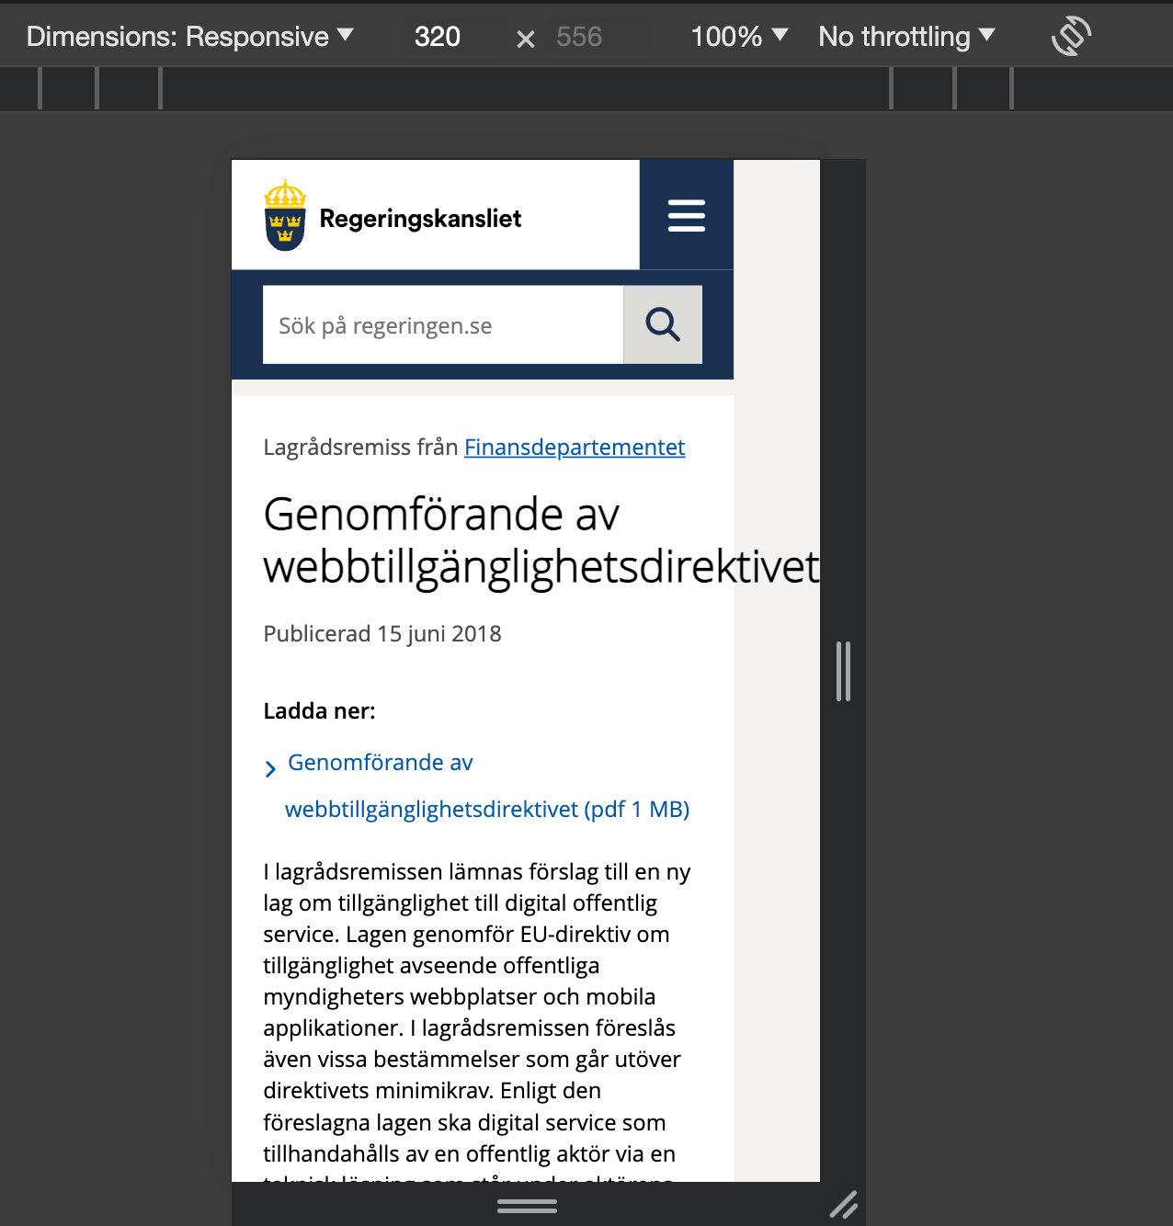
WCAG 2.1 1.4.10 Reflow (AA)

Slide 16
Keyboard

Slide 17
The interface can be controlled by keyboard on both desktop and mobile
This also includes that the user should not have to time inputs in order to navigate and the user should be able to navigate in and out of functions/components, regardless of input method.
WCAG 2.1 2.1.1 (A) | 2.1.2 (A) | 3.2.1 (A) | 3.2.2 (A)

Slide 18
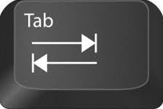
Keyboard navigation follows a logical order
HTML5 has many elements with embedded keyboard navigation like buttons, inputs, links etc.
Navigation is usually done with the tab or arrow keys.
Keyboard navigation follows how the objects are placed in the code.
Can be determined automatically by default structure (recommended) or manually by specifying the order.
EXAMPLE
1
2
3
WCAG 2.1 2.4.3 Focus Order (A)

Slide 19
Keyboard navigation follows a logical order
tabindex = "0"
- allowing any element to be focusable and to trigger an interaction. Follows the structural order in the code. Use only when necessary.
tabindex = "1"…
- used to control TAB-order. NOT recommended unless it´s required.
tabindex ="-1"
- used when elements only should be focusable in certain circumstances. (e.g modal dialog)
WCAG 2.1 2.4.3 Focus Order (A)

Slide 20
Focus is clearly displayed when users navigate with the keyboard
When the user navigates with a keyboard on a website or in a function, the focus must be clearly displayed.
Hidden links and shortcuts should also be highlighted and displayed visually when they receive focus with keyboard navigation.
WCAG 2.1 2.4.7 Focus Visible (AA)

Slide 21
Keyboard focus

Slide 22
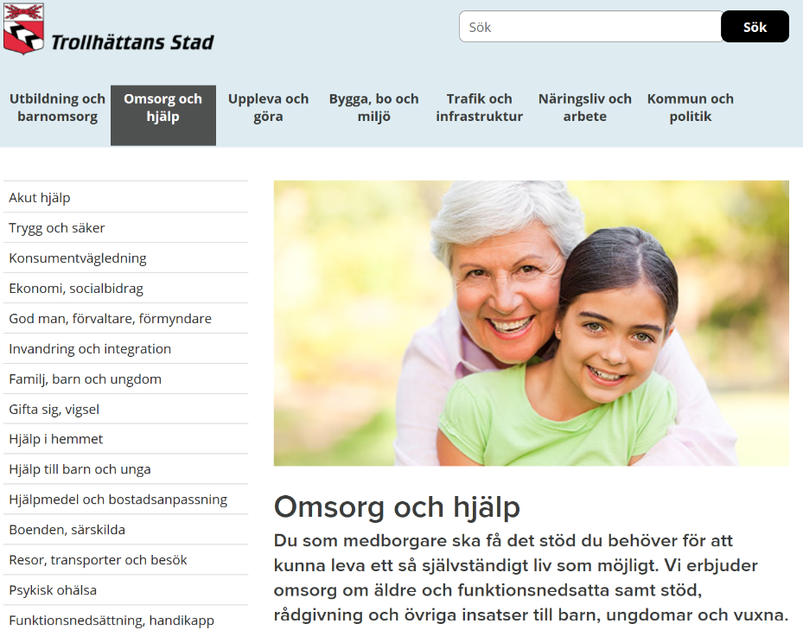
Focus is clearly displayed when users navigate with the keyboard
WCAG 2.1 2.4.7 Focus Visible (AA)

Slide 23
Focus is clearly displayed when users navigate with the keyboard
The highlight needs to be easily identifiable, so the built-in focus highlight in web browsers may not be enough.
Use a thicker border, thick underlining, inversion of color, etc.
Default is approved
Specified is better
WCAG 2.1 2.4.7 Focus Visible (AA)

Slide 24
Landmarks

Slide 25
Link groups and information areas are grouped
This requirement helps the user identify groups of objects/elements and their role in the interface.
Use landmarks to mark different types of content, it provides an additional structure for users who can´t see.
EXAMPLE
<nav>
<header>
<footer>
<main>
<article>
………..
WCAG 2.1 1.3.1 Info and Relationships (A)

Slide 26
Link groups and information areas are grouped
Use at least the structural elements <nav> and <main>. Also use the wai-aria attribute role="search" for the search form.
Don’t use the role attribute if there is an equivalent HTML5 element.
EXAMPLE
<nav aria-label="Top menu">
<ul>
<li>
<a href="/design-for-all/">
Design for all
</a>
</li>
</ul>
</nav>
<div role="search">
<input type="search">
<input type="submit“ value="Search">
</div>
WCAG 2.1 1.3.1 Info and Relationships (A)

Slide 27

Link groups and information areas are grouped
<header>
role="search"
<nav>
<main>
<footer>
WCAG 2.1 1.3.1 Info and Relationships (A)

Slide 28
Extended descriptions

Slide 29
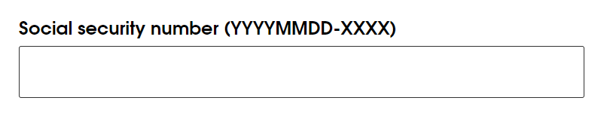
Extended descriptions of a particular form field is tied to that specific field
Preferably use the label element that contains the prompt.
<label for="socialnumber">Social security number (YYYYMMDD-XXXX)</label>
<input id="socialnumber" type="number">
WCAG 2.1 1.3.1 Info and Relationships (A)

Slide 30
Extended descriptions of a particular form field is tied to that specific field
<label for="mapLink">Karta</label>
<span id="extraInfo" class="info">
Klistra in en kartlänk från maps.google.se
</span>
<input id="mapLink" type="text" aria-describedby="extraInfo">
WCAG 2.1 1.3.1 Info and Relationships (A)

Slide 31
2: När är WAI-ARIA viktigt, och inte! ☺

Slide 32
Some of the rules of ARIA

Slide 33
First Rule of ARIA Use
If you can use a native HTML element or attribute with the semantics and behavior you require already built in, instead of re-purposing an element and adding an ARIA role, state or property to make it accessible, then do so.
WCAG 2.1 4.1.2 Name, Role, Value (A)

Slide 34
Second Rule of ARIA Use
Do not change native semantics, unless you really have to.
For example: Developer wants to build a heading that's a tab.
Do not do this:
<h2 role=tab>heading tab</h2>
Do this:
<div role=tab><h2>heading tab</h2></div>
WCAG 2.1 4.1.2 Name, Role, Value (A)

Slide 35
Use wai-aria in order to convey information that cannot be conveyed through the use of HTML and that benefits users
Before using a wai-aria attribute, you need to know how it is used and if it really provides a benefit to users.
EXAMPLE
The overlap between HTML and wai-aria is limited.
html5
wai-aria
WCAG 2.1 4.1.2 Name, Role, Value (A)

Slide 36
Use wai-aria in order to convey information that cannot be conveyed through the use of HTML and that benefits users
Before using a wai-aria attribute, you need to know how it is used and if it really provides a benefit to users.
EXAMPLE
The overlap between HTML and wai-aria is limited.
html5
wai-aria
WCAG 2.1 4.1.2 Name, Role, Value (A)

Slide 37
Status changes

Slide 38
When status is changed, users of assistive technologies are informed without focus being moved
When a status message is shown on screen the user should be informed of that without moving focus.
This could for example be:
A change in an ongoing process
The number of hits in a search function
Live validation in a form
WCAG 2.1 4.1.3 Status Messages (AA)

Slide 39
When status is changed, users of assistive technologies are informed without focus being moved
Use the following values:
Off = Use for something that is frequently updated, for example stock market information.
Polite = If the user should be notified of a change only if they are not doing anything important.
Assertive = Use when something important occurs of which the user should be notified about as soon as possible.
EXAMPLE
<div aria-live="polite">
Read this to the
user when they aren’t
doing anything
important
</div>
<div aria-live="assertive">
Read this now!
</div>
WCAG 2.1 4.1.3 Status Messages (AA)

Slide 40
Expanded or not expanded?

Slide 41
Use aria-expanded for areas that can be expanded and collapsed
Aria-expanded is added to the button (or link) that expands the area.
True indicates the area is expanded, false that it is collapsed. These values must be dynamically set.
EXAMPLE
<button aria-expanded="true">
Open/Close
</button>
<div>
Content
</div>
WCAG 2.1 4.1.2 Name, Role, Value (A)

Slide 42
Use aria-expanded for areas that can be expanded and collapsed
<button aria-expanded="true">Menu</button>
<nav>
<ul>
<li>
<a href="/design-for-all/">Design for all</a>
<button aria-expanded="false">Sub menu for Design for all</button>
</li>
<li>
<a href="/we-offer/">We offer</a>
<button aria-expanded="false">Sub menu for We offer</button>
</li>
</ul>
</nav>
WCAG 2.1 4.1.2 Name, Role, Value (A)

Slide 43
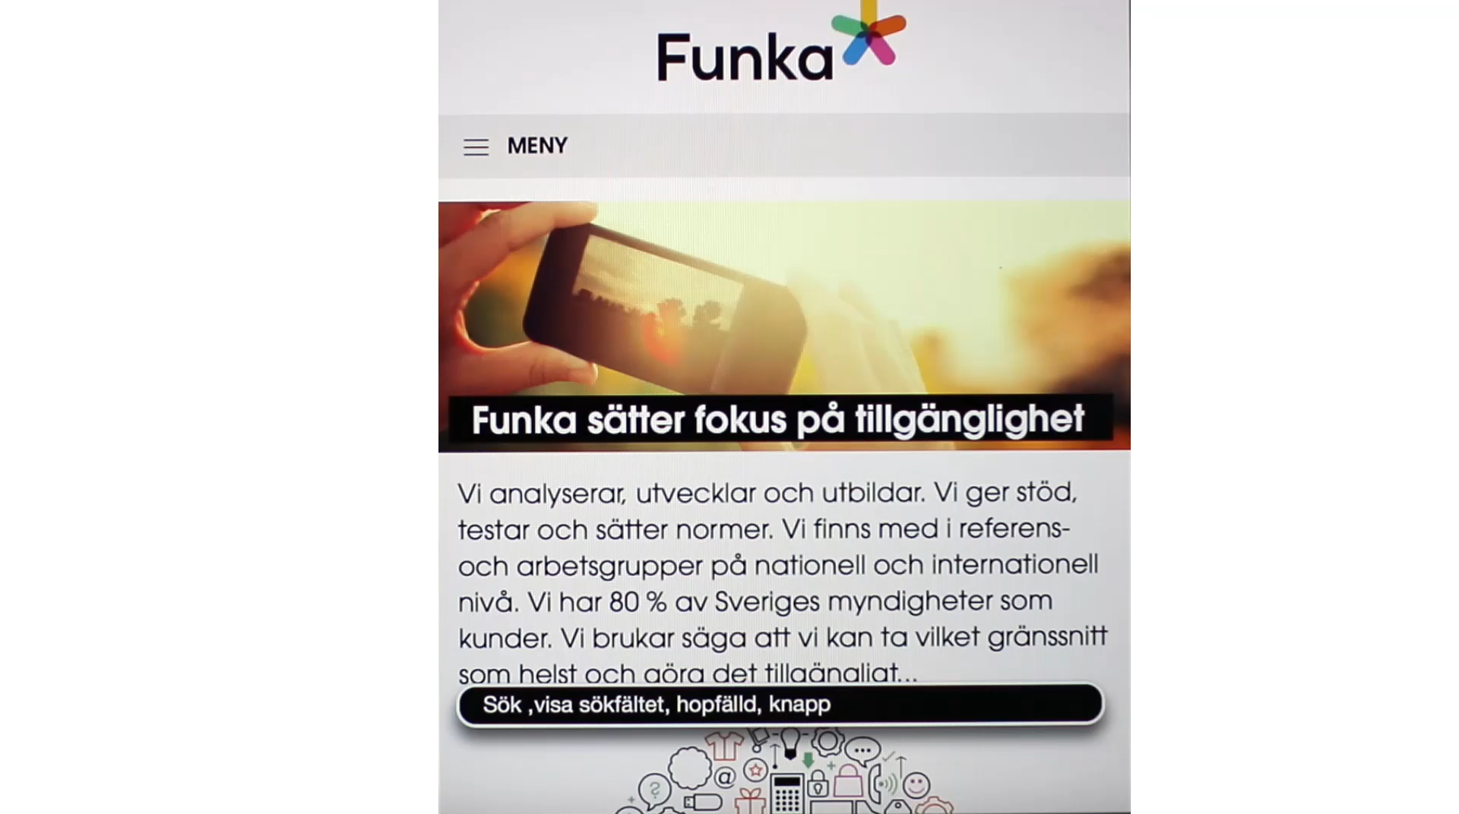
SW100) Use aria-expanded for areas that can be expanded and collapsed

Slide 44
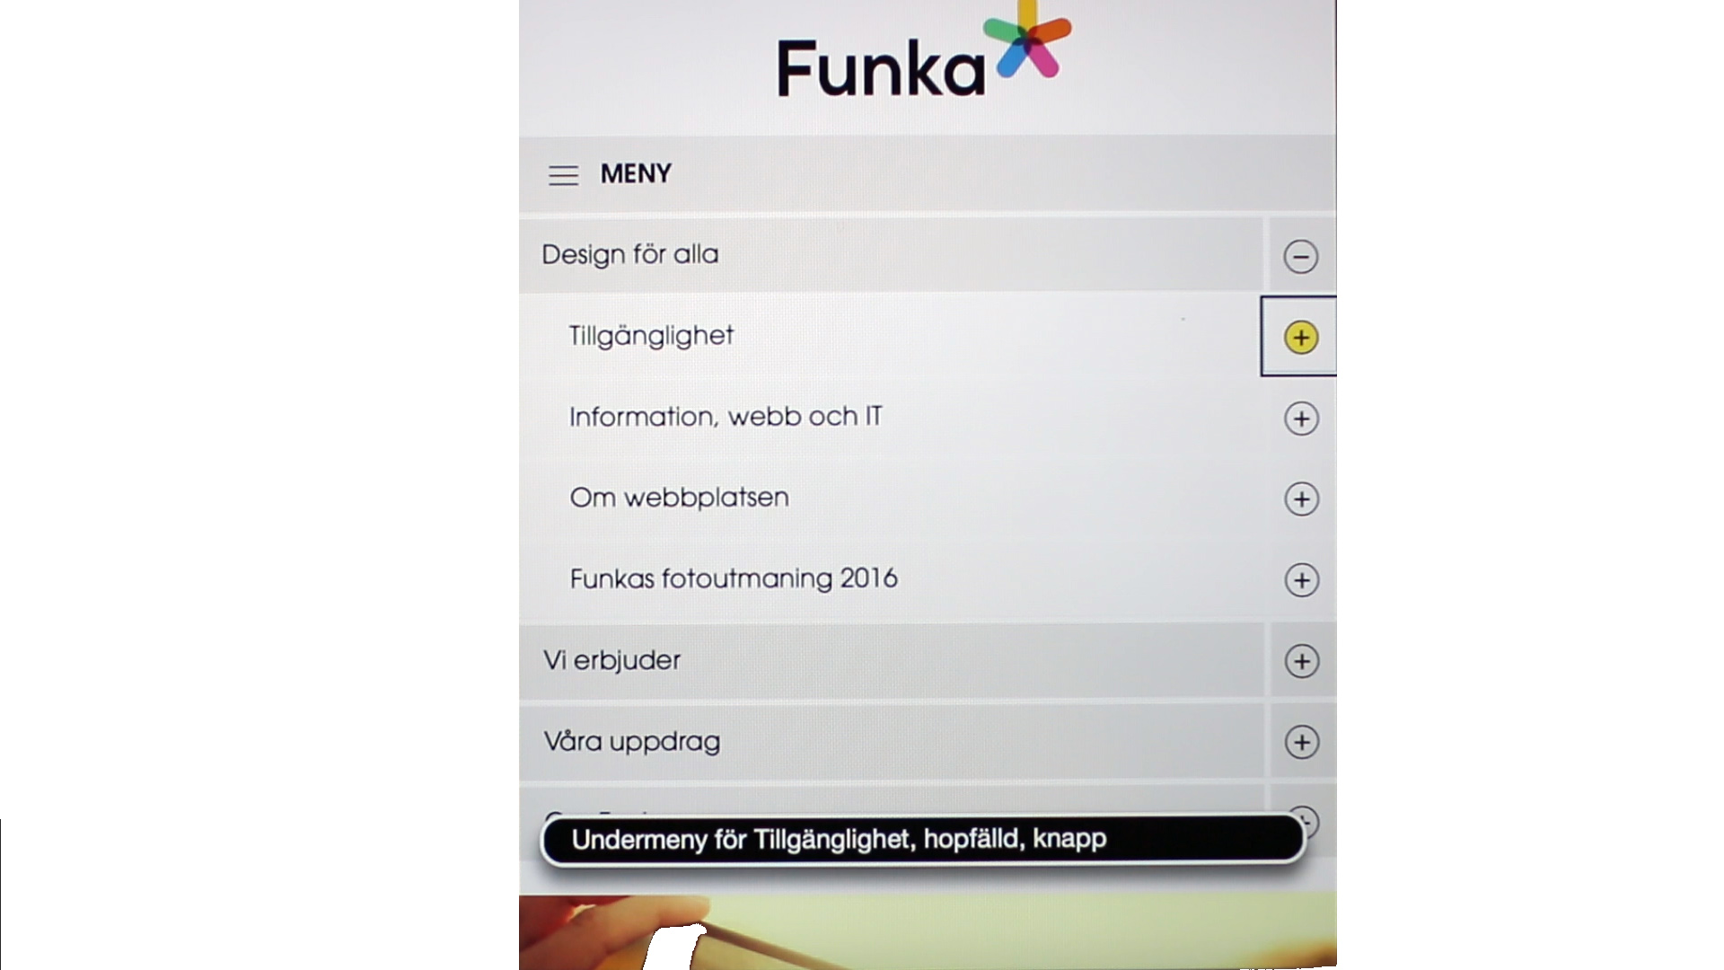
SW100) Use aria-expanded for areas that can be expanded and collapsed

Slide 45
Do not overuse!

Slide 46
Don’t overuse WAI-aria
Name:
<label id="label" for="text" aria-hidden="false">Name</label>
<input id="text" role="input" type="text"
aria-label="Name" aria-labelledby="label" aria-describedby="label"
aria-multiline="false" aria-readonly="false"
aria-required="true" required aria-invalid="false"
aria-hidden="false" aria-disabled="false" />
<label for="text">Name</label>
<input id="text" required type="text" />
Tips

Slide 47
Gratis bra verktyg!

Slide 48
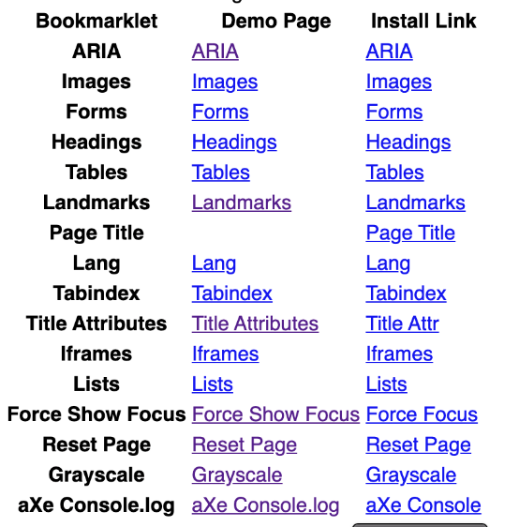
Bokmärken från Paul J Adam
Bokmärken från Paul J Adam kan bland annat visa rubriknivåer och alt-texter
pauljadam.com/bookmarklets/
Tips

Slide 49
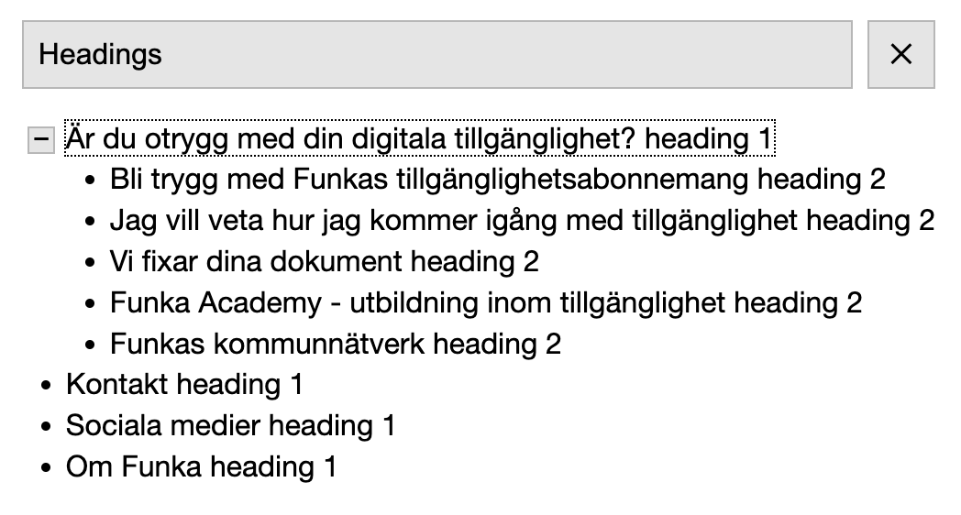
Bokmärket a11y- outline
Bokmärket a11y- outline kan bland annat lista rubriker
https://xi.github.io/a11y-outline/
Tips

Slide 50
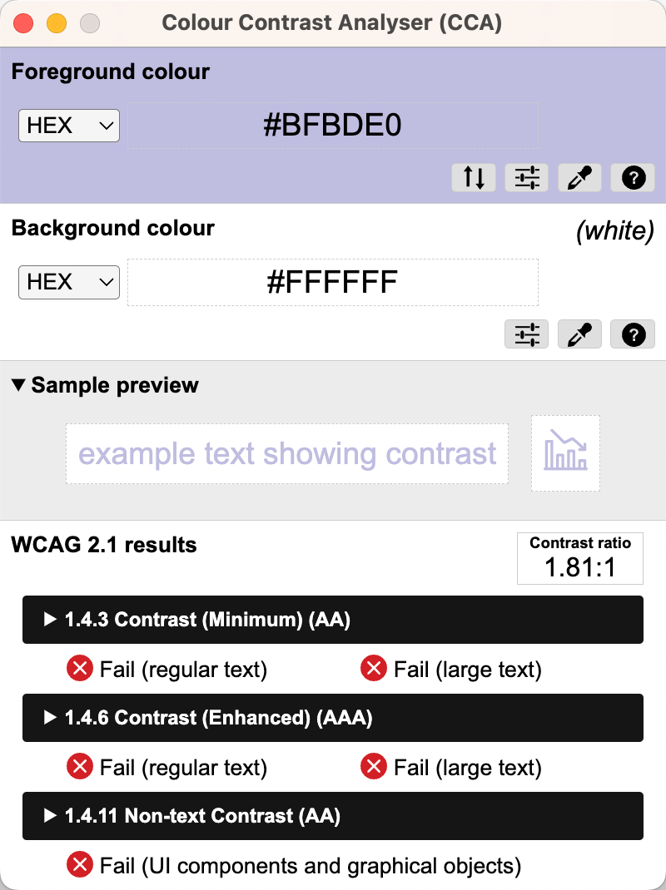
Colour Contrast Analyser
Colour Contrast Analyser är ett verktyg för att mäta kontraster
https://www.tpgi.com/color-contrast-checker/
Tips

Slide 51
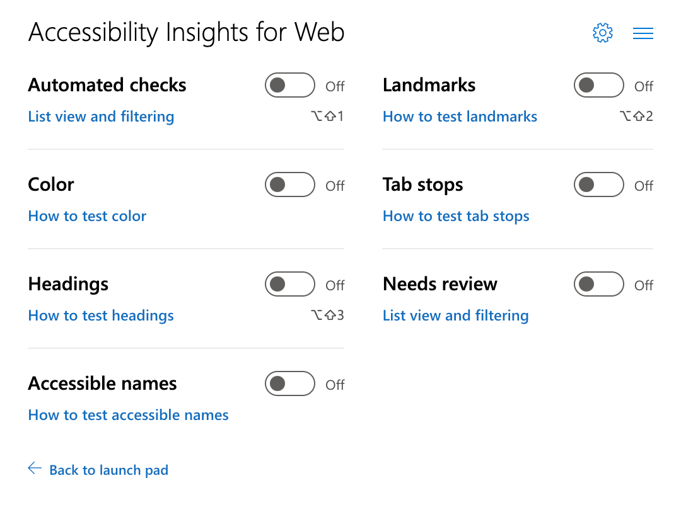
Accessibility Insights
Accessibility Insights är en program med flera testverktyg, bland annat bra visuella verktyg i Ad Hoc Tools
https://accessibilityinsights.io/
Tips

Slide 52
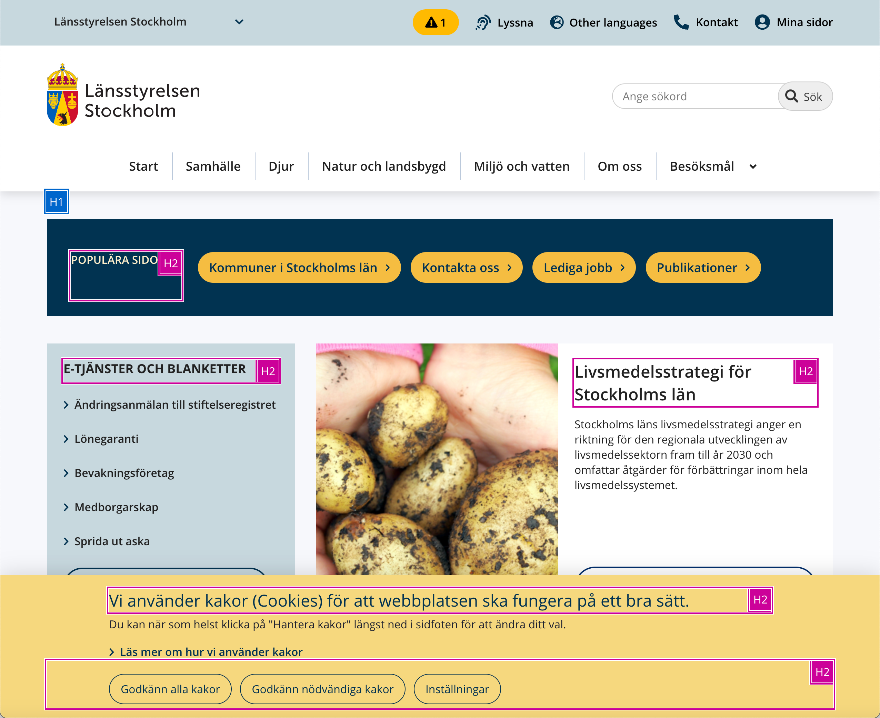
Accessibility Insights
Tips

Slide 53
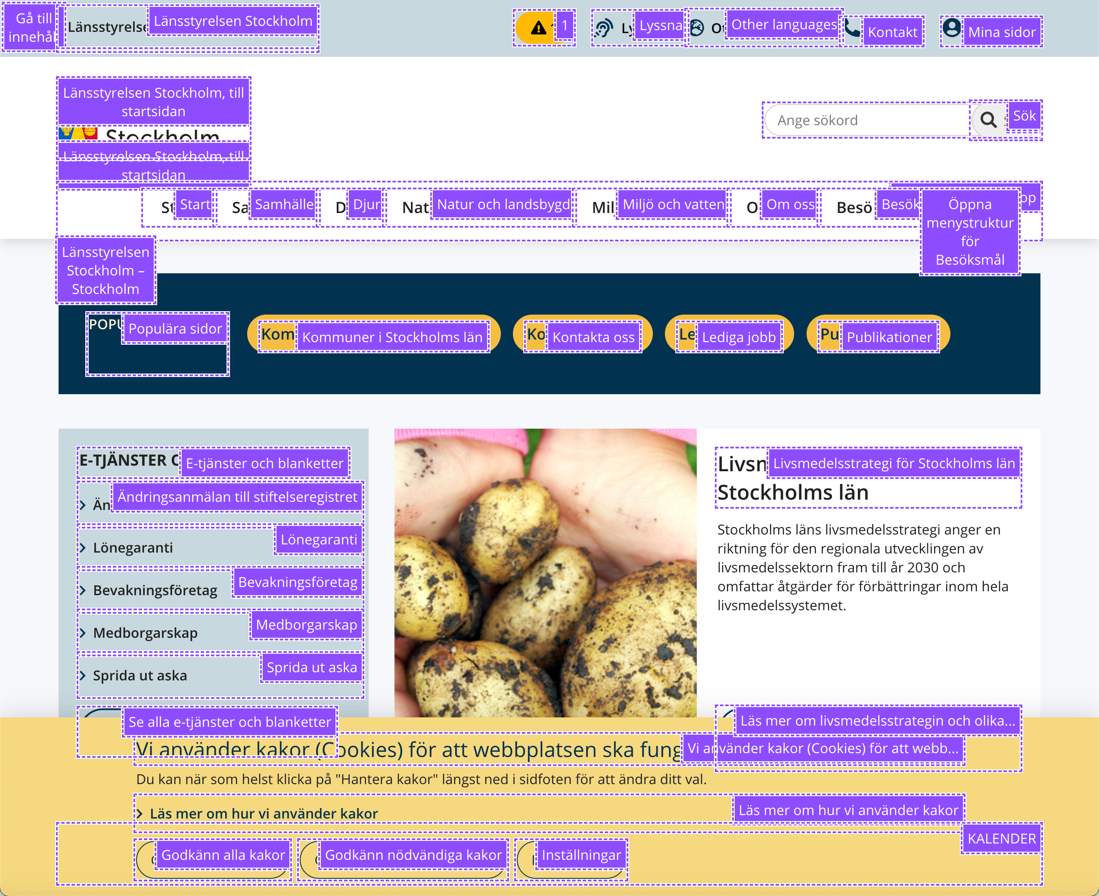
Accessibility Insights
Tips

Slide 54
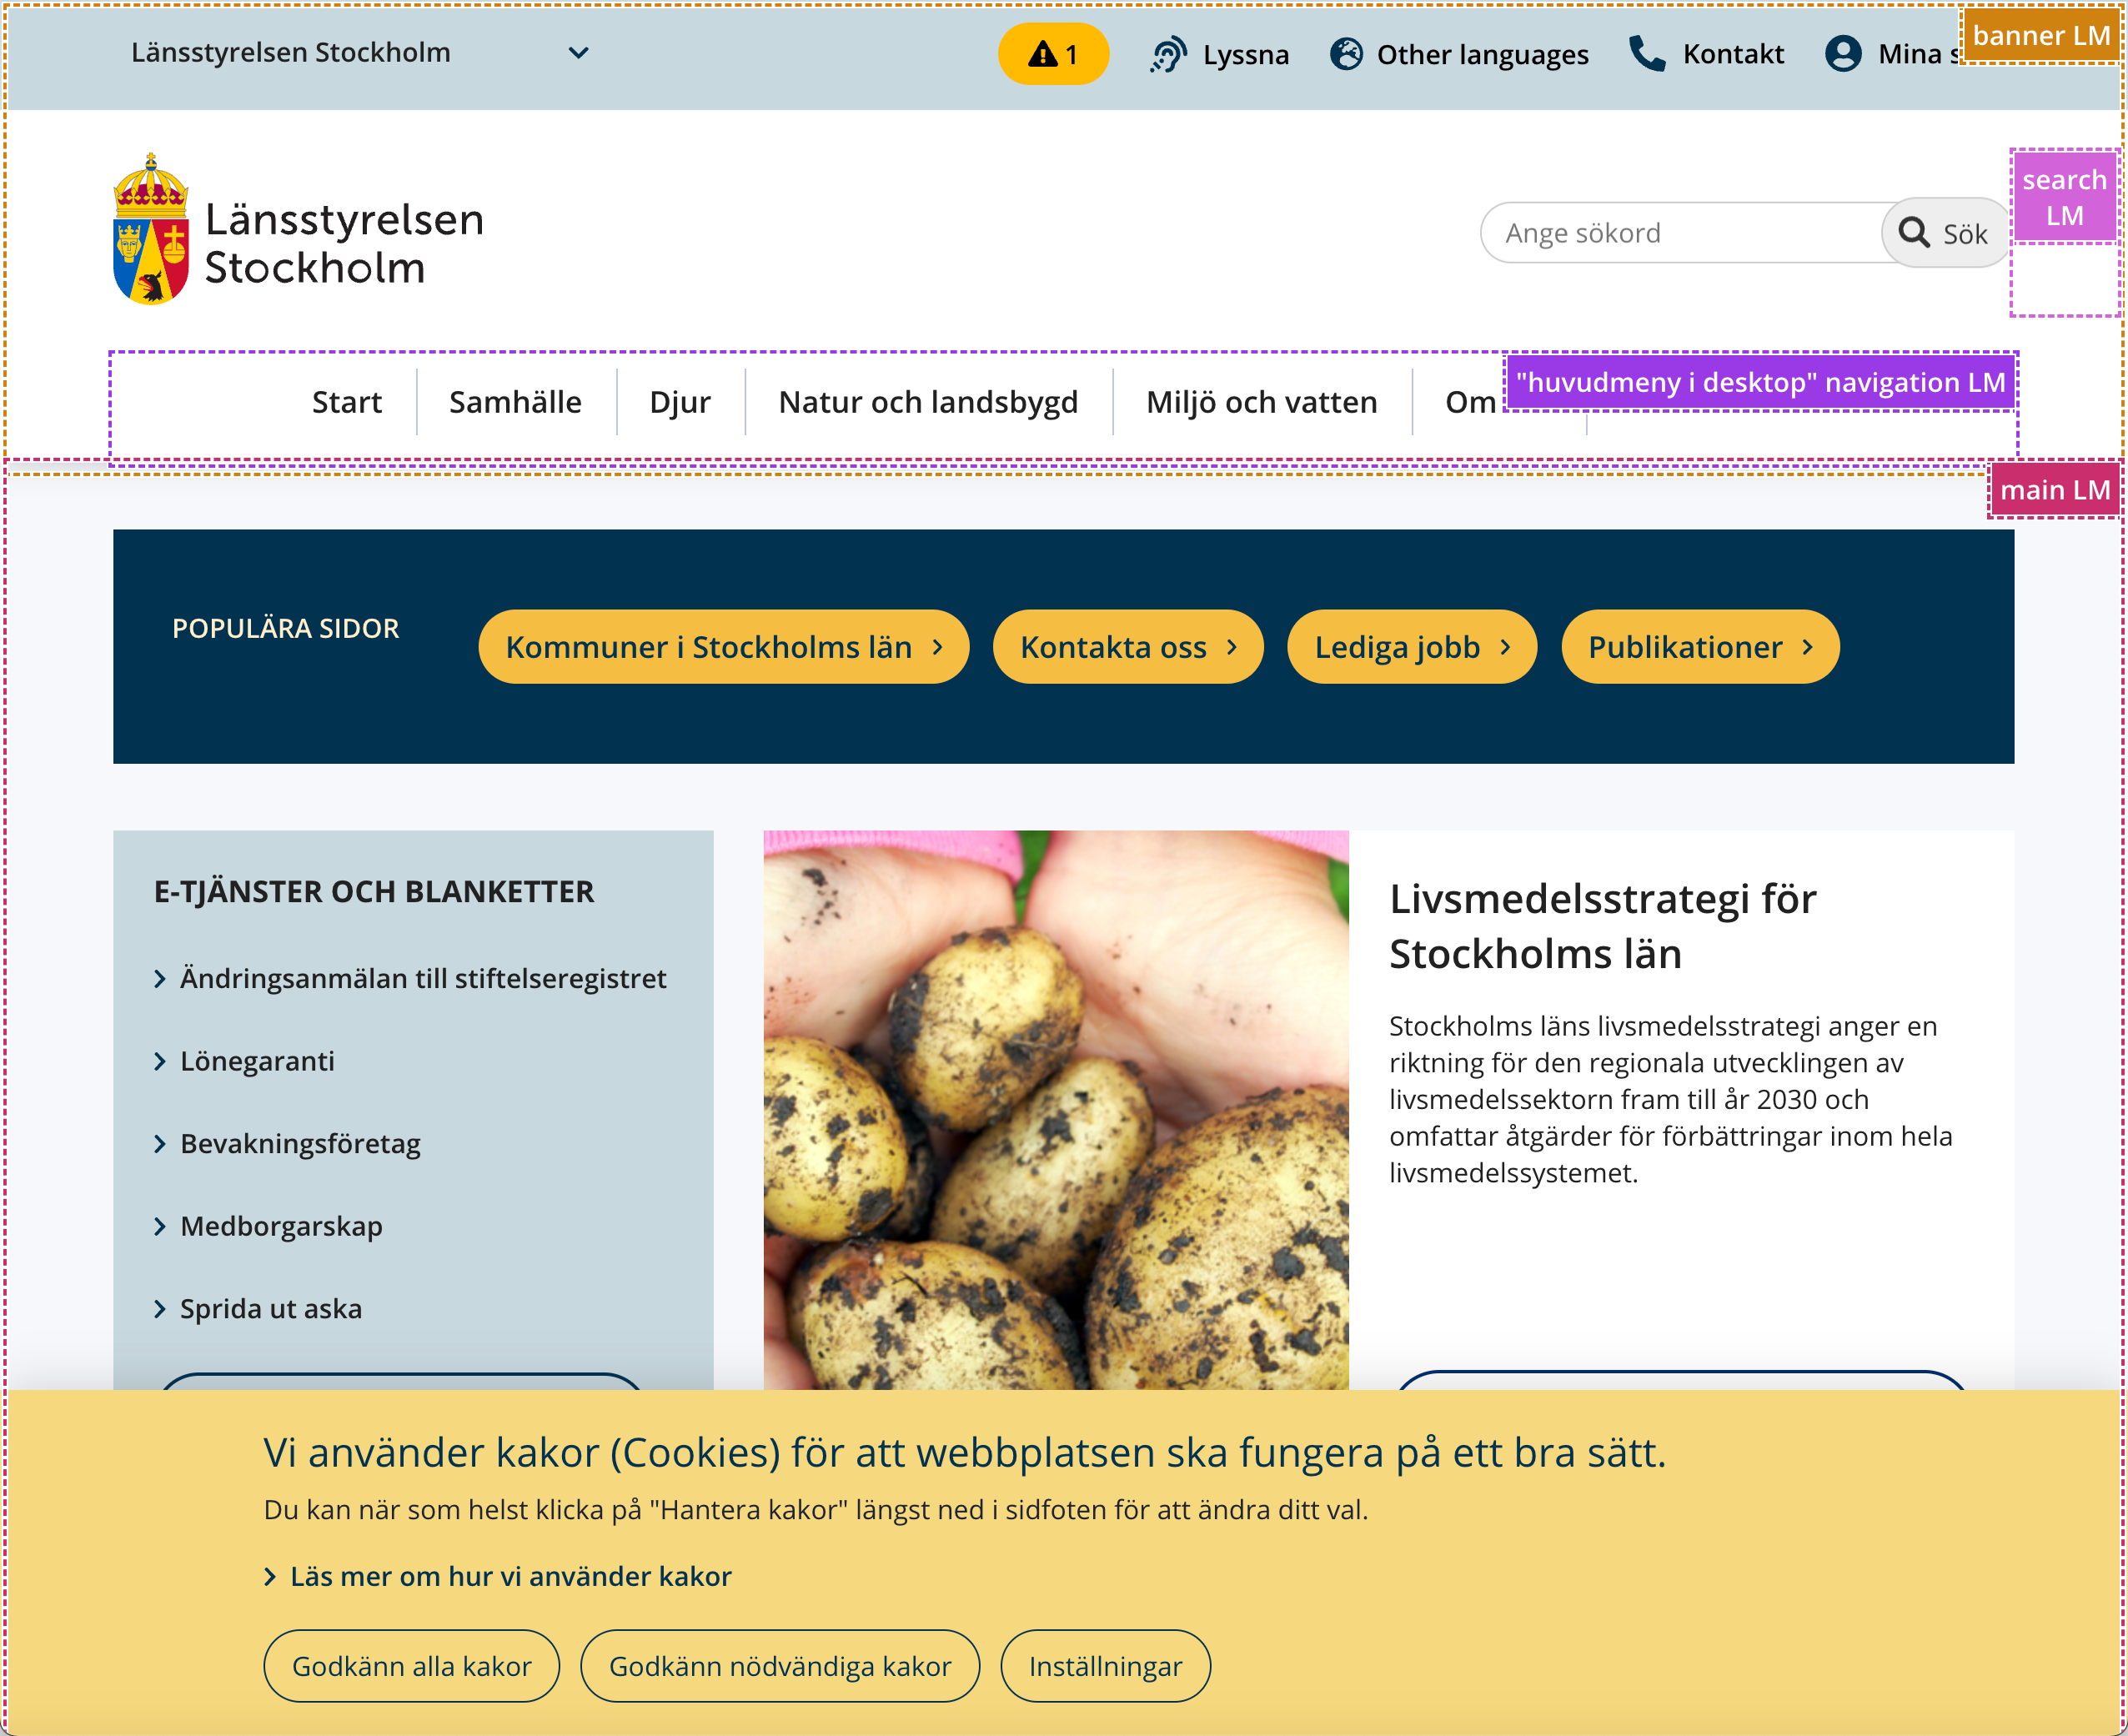
Accessibility Insights
Tips

Slide 55
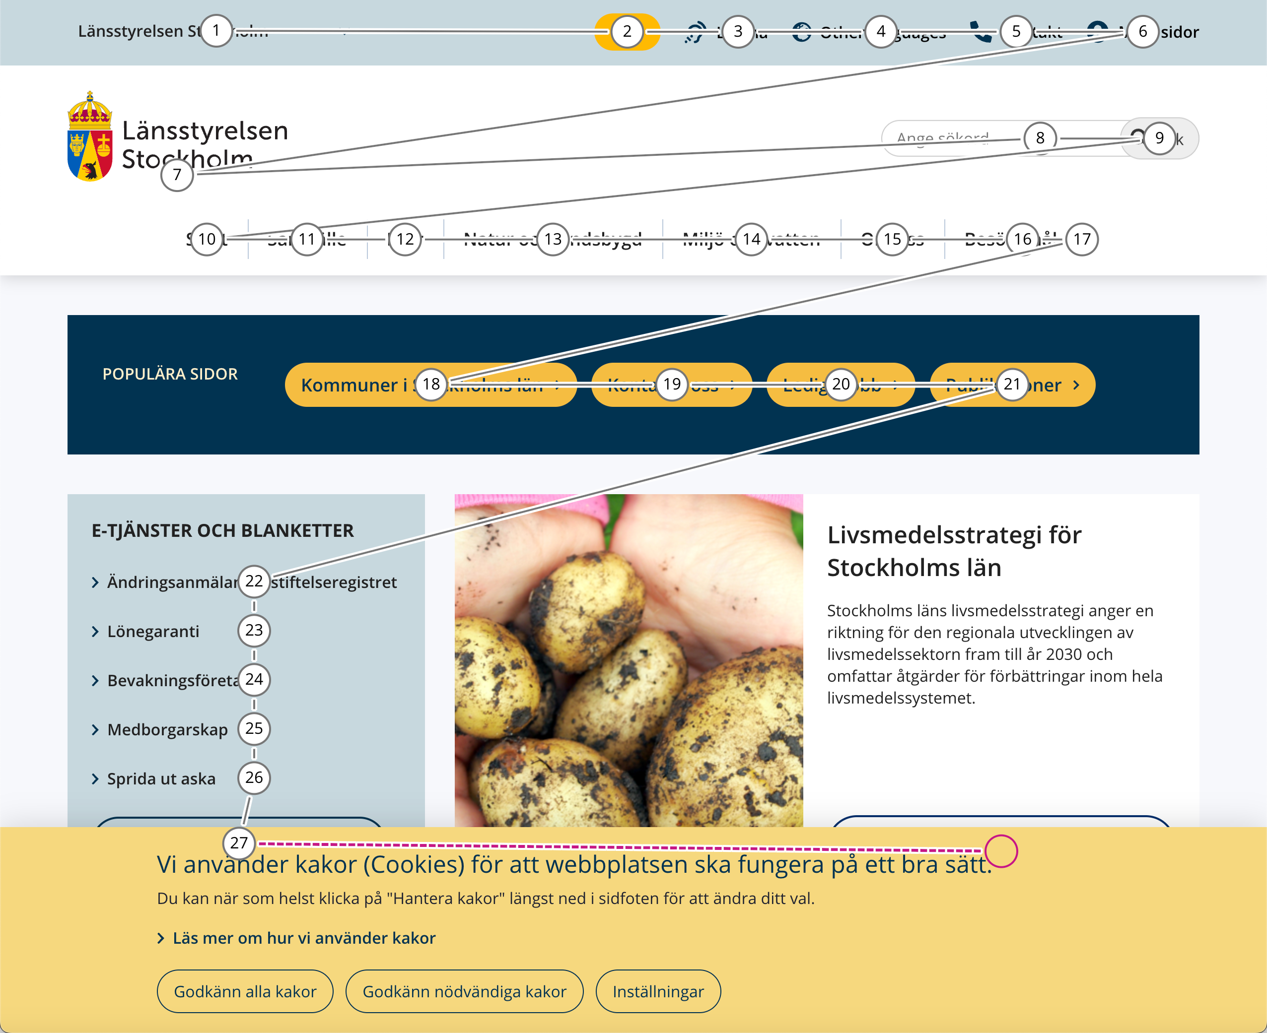
Accessibility Insights
Tips

Slide 56
3: Diskussion och frågor

Slide 57




Slide 58
Det finns inga normalanvändare

